Slide 1
Predictive Attrition Insights Through Interactive Dashboards
MOHAMED SAHAD M I
Batch : E
DATE: 05/04/2025

Slide 2
Introduction
High attrition rates in the company are impacting productivity and increasing costs. This project aims to analyze the Emp_attrition_csv.csv dataset to identify the key factors driving attrition and build a predictive model to identify employees at risk of leaving, enabling proactive retention strategies.
Business Impact of Employee Attrition: High attrition rates increase hiring costs, reduce productivity, and affect team morale. Predicting attrition helps businesses save costs, improve employee retention, enhance workplace satisfaction, and enable better workforce planning through data-driven insights.
Role of Machine Learning in Solving Employee Attrition: Machine Learning analyzes historical employee data to identify key attrition factors, predict at-risk employees, and provide data-driven insights for proactive retention strategies. It helps HR teams optimize workforce planning, reduce turnover costs, and improve employee satisfaction

Slide 3
Objectives
To analyze employee turnover data and identify key factors that contribute to attrition, using machine learning models to predict employee churn.
Predict Employee Attrition – Build a model to predict whether an employee is likely to leave.
Identify Key Drivers – Determine the most influential factors leading to attrition.
Improve Employee Retention – Provide actionable insights for HR teams to reduce turnover.
Enhance Decision-Making – Support data-driven HR strategies with predictive analytics

Slide 4
Dataset
Source: Employee turnover dataset ( open datasets such as Kaggle).
Features: Includes attributes such as Employee ID, Age, Department, Job Satisfaction, Salary, Work Environment, Overtime, and Attrition Status.
Size: Contains thousands of employee records collected over multiple years (74610 , 24)
Data Type: Structured tabular data with categorical and numerical variables
Challenges:
Missing values in some columns (handled using imputation techniques).
Imbalanced dataset (more employees staying vs. leaving).
Need for feature selection to remove irrelevant attributes

Slide 5
Methodology
Exploratory Data Analysis (EDA)
Visualized trends (attrition by age, salary, overtime, etc.
Detected outliers and imbalanced data
Data Preprocessing :
Data Cleaning: Removed duplicates, handled missing values, Remove outliers
Encoding: Converted categorical variables using Ordinal/One-Hot Encoding
Normalization: Scaled numerical features for model compatibility
Feature Selection :
Selected important predictors using correlation analysis & model-based importance.

Slide 6
Methodology
Model Evaluation
Compared using Accuracy, Precision, Recall, F1-score, and ROC AUC
Prediction
Final model predicts if an employee is likely to leave the company
MYSQL
Connected PowerBI and MySQL
Use Trigger

Slide 7
Model Selection & Implementation
Model Selection & Implementation
Model Building
Algorithms Used :
Logistic Regression
Simple, interpretable, ideal for binary classification like attrition (Yes/No)
Decision Tree
Simple, interpretable, ideal for binary classification like attrition (Yes/No)
Random Forest
Easy to understand and visualize. Captures non-linear relationships.
XGBooster(Best Performance)
Ensemble method, handles overfitting better, good for medium-sized datasets

Slide 8
Training Process :
Train Test Split:
80% training, 20% testing split for evaluating generalization performance
Hyperparameter Tuning (for XGBoost ):
Grid Search and Random Search used to optimize parameters like max_depth, n_estimators, learning_rate.

Slide 9
Evaluation & Results
Metrics Used :
Accuracy: Overall correctness of predictions
Precision: Correct positive predictions over total predicted positives
Recall: Correct positive predictions over actual positives
F1-Score: Harmonic mean of precision and recall
ROC AUC: Overall model performance across classification thresholds

Slide 10
Model Performance Comparison :
Model | Accuracy | Precision | Recall | F1-score | ROC AUC
Logistic Regression | 0.72 | 0.68 | 0.60 | 0.64 | 0.70
Decision Tree | 0.70 | 0.65 | 0.62 | 0.63 | 0.68
Random Forest | 0.74 | 0.72 | 0.70 | 0.71 | 0.73
XGBoost | 0.7589 | 0.7433 | 0.7469 | 0.7451 | 0.7583

Slide 11
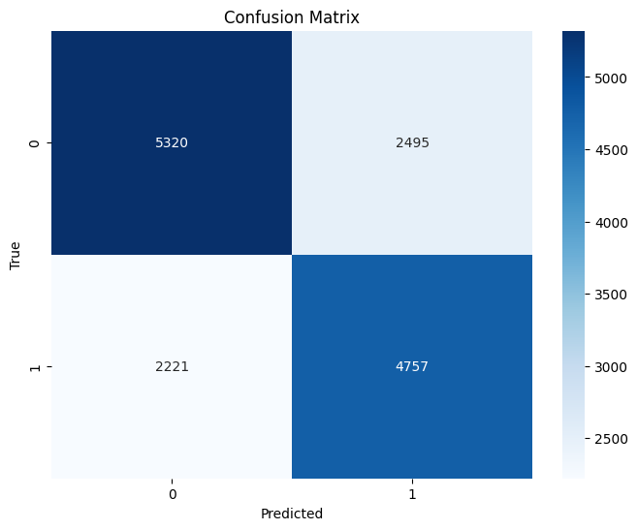
Confusion Matrix:
True Positives (TP = 4757): These are the employees who were predicted to leave, and they actually did
True Negatives (TN = 5320): These are the employees predicted to stay, and they did stay.
❌ False Positives (FP = 2495): These are employees predicted to leave, but they actually stayed.
❌ False Negatives (FN = 2221): These are employees predicted to stay, but they ended up leaving.

Slide 12
Dashboard Overview

Slide 13
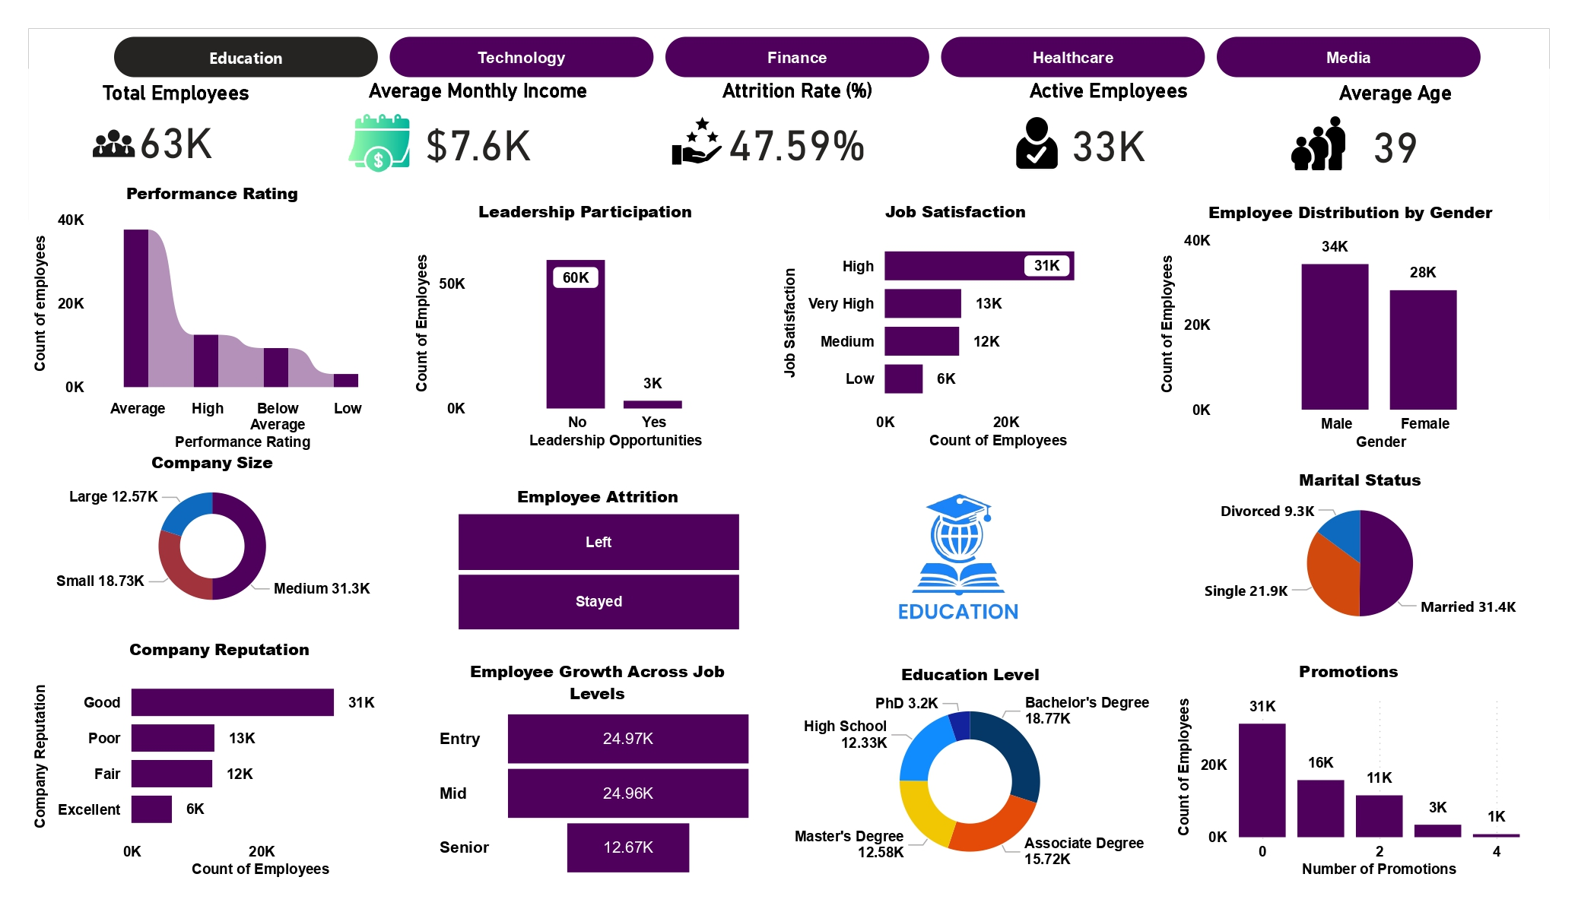

Slide 14
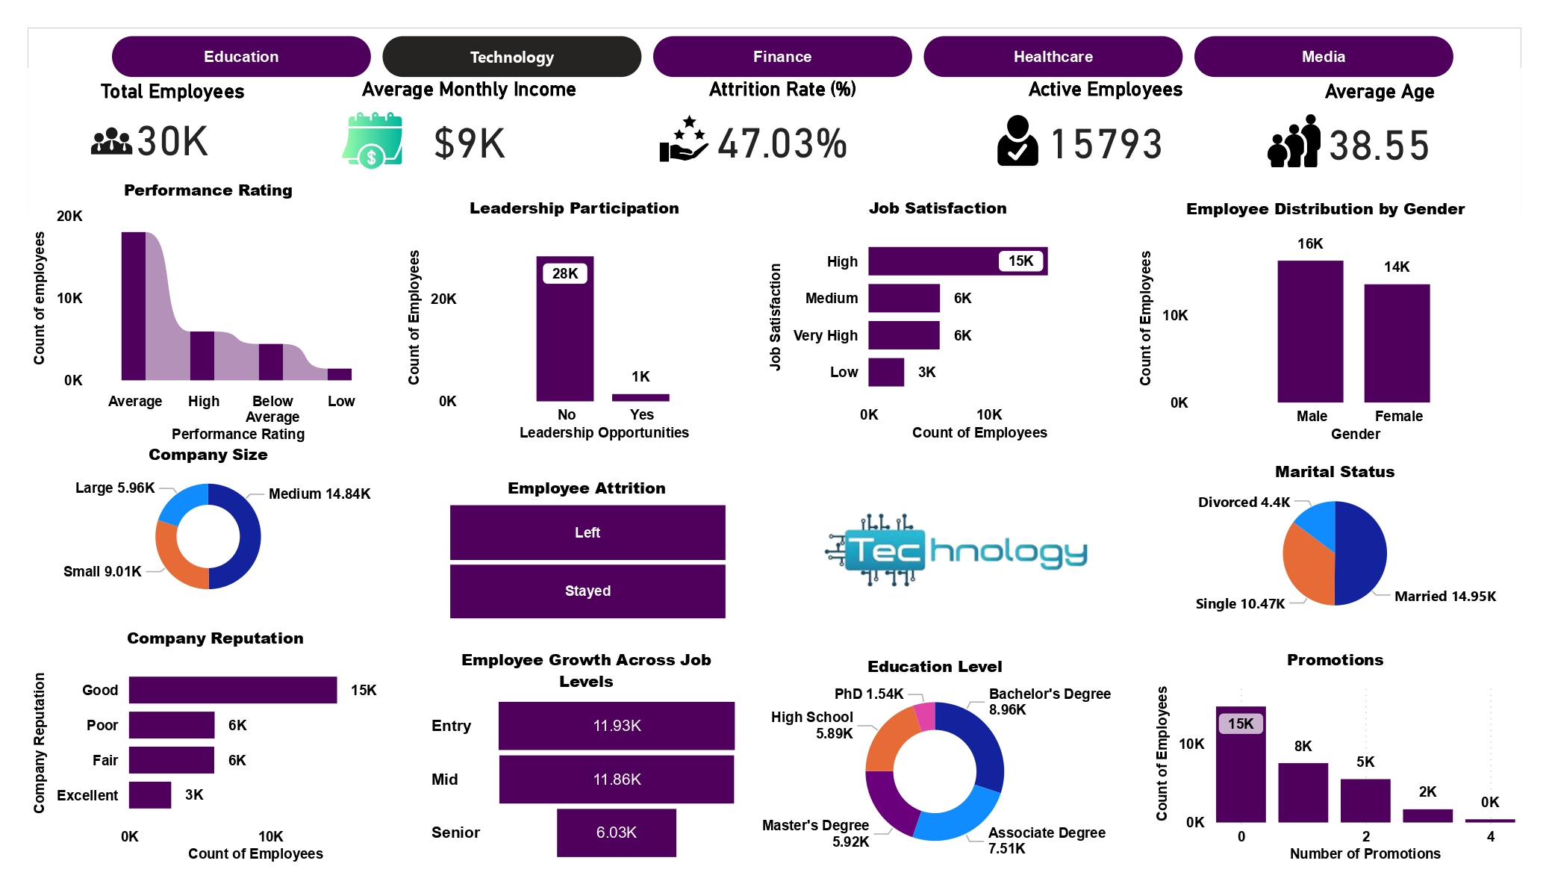

Slide 15
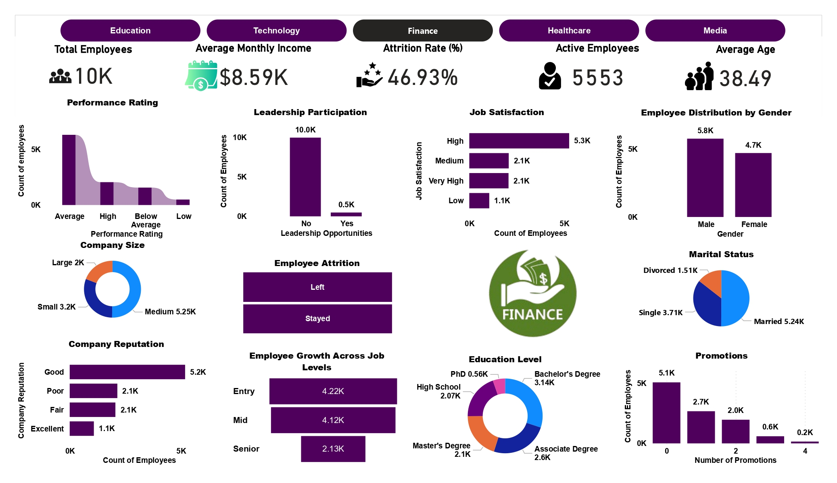

Slide 16
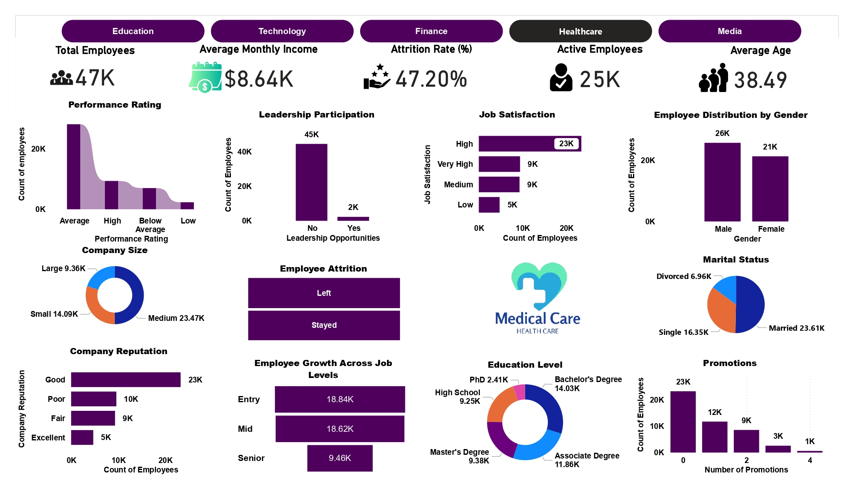

Slide 17
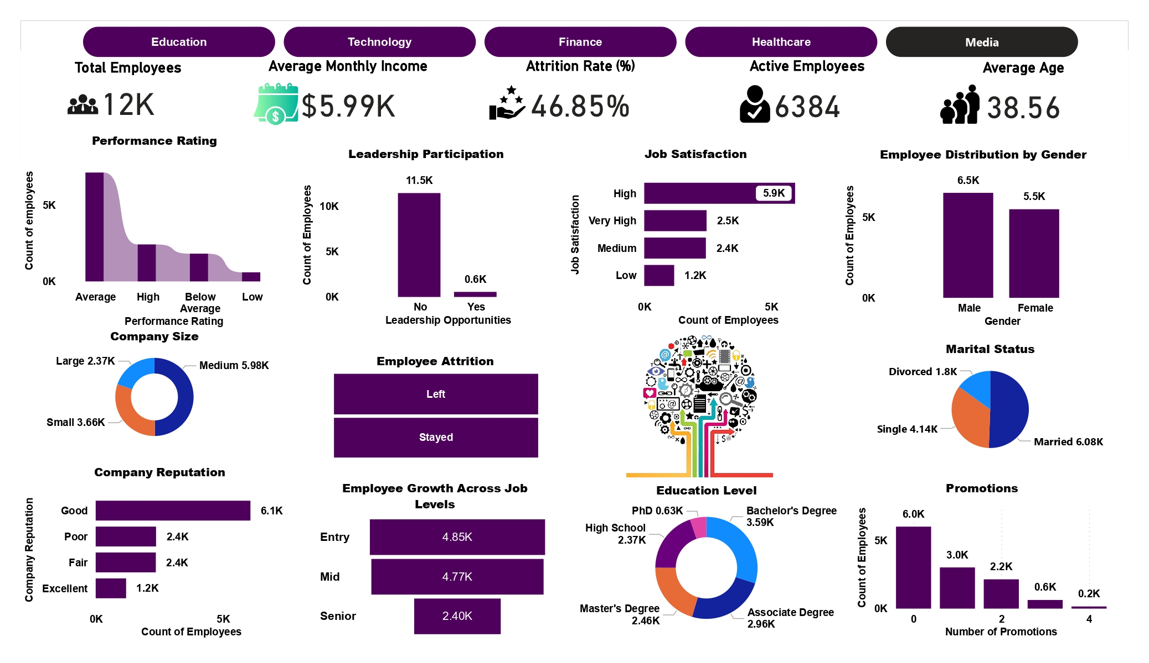

Slide 18
Challenges & Limitations
Challenges Faced:
Data Quality Issues: Missing values and inconsistent entries required extensive preprocessing
Class Imbalance: Uneven distribution between employees who stayed vs. those who left made it harder for some models to learn.
Feature Engineering: Identifying relevant features that impact attrition took time and domain understanding.
Computational Load: Training advanced models like XGBoost required more processing time and memory.
⚠️ Limitations of the Approach:
Black-box Models: Models like XGBoost offer high accuracy but low interpretability—making it harder to explain decisions to HR teams.
Black-box Models: Models like XGBoost offer high accuracy but low interpretability—making it harder to explain decisions to HR teams.
Limited External Factors: Personal and external factors affecting attrition (e.g., job market trends) weren't captured in the dataset.

Slide 19
Challenges & Limitations
⚖️ Trade-offs:
Accuracy vs. Interpretability: We chose XGBoost for its strong predictive performance, but it's harder to explain than simpler models like Logistic Regression.
Accuracy vs. Interpretability: We chose XGBoost for its strong predictive performance, but it's harder to explain than simpler models like Logistic Regression.

Slide 20
Conclusion & Future Work
Conclusion:
Successfully developed and evaluated multiple machine learning models to predict employee attrition.
XGBoost achieved the best overall performance across all key metrics (Accuracy, Precision, Recall, F1-Score, ROC AUC).
The project highlights important predictors of employee turnover, which can assist HR teams in proactive decision-making.
🚀 Future Work:
🔍 Improvements & Enhancements:
Better Data Collection: Incorporate more detailed employee data (e.g., engagement surveys, external factors).
Advanced Modeling: Explore deep learning or ensemble stacking for further performance gains.

Slide 21
Conclusion & Future Work
🌐 Real-World Application:
Deploy as a Web App: Use platforms like Streamlit for real-time attrition prediction.
Integration with HR Systems: Embed the model into existing employee management software.
Continuous Learning: Implement a pipeline that retrains the model with new data regularly.

Slide 22
THANK YOU

